Slide 1
How to register taaf teams online (new online registration system)

Slide 2
New Steps
Step 1 - # of registered teams by sport
Step 2 – renaming # of registered teams to correct team name
Step 3 – uploading or adding in roster/coach information
Step 4 – uploading copies of waivers/birth certificates

Slide 3
Team registrations

Slide 4
You will go to www.taaf.com – Member Cities Only – Downloadable Files and Links

Slide 5
Completing step 1
Verify your membership with your Member ID and Access Code
Beside each sport and correct division, enter the number of teams you have
Example: (35) 11U Youth Flag Football – 21 (teams)
Keep entering number of teams per sport till you have entered them all, click SUBMIT.

Slide 6
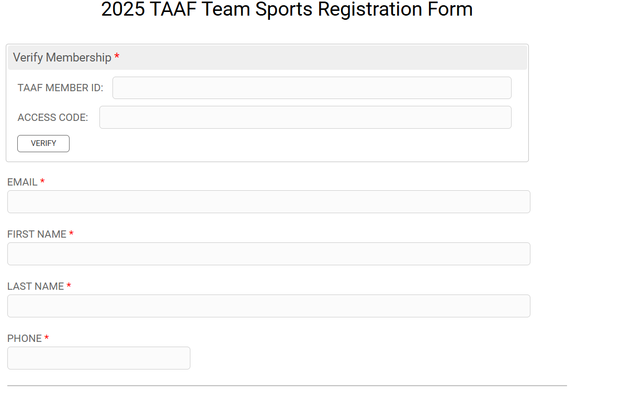
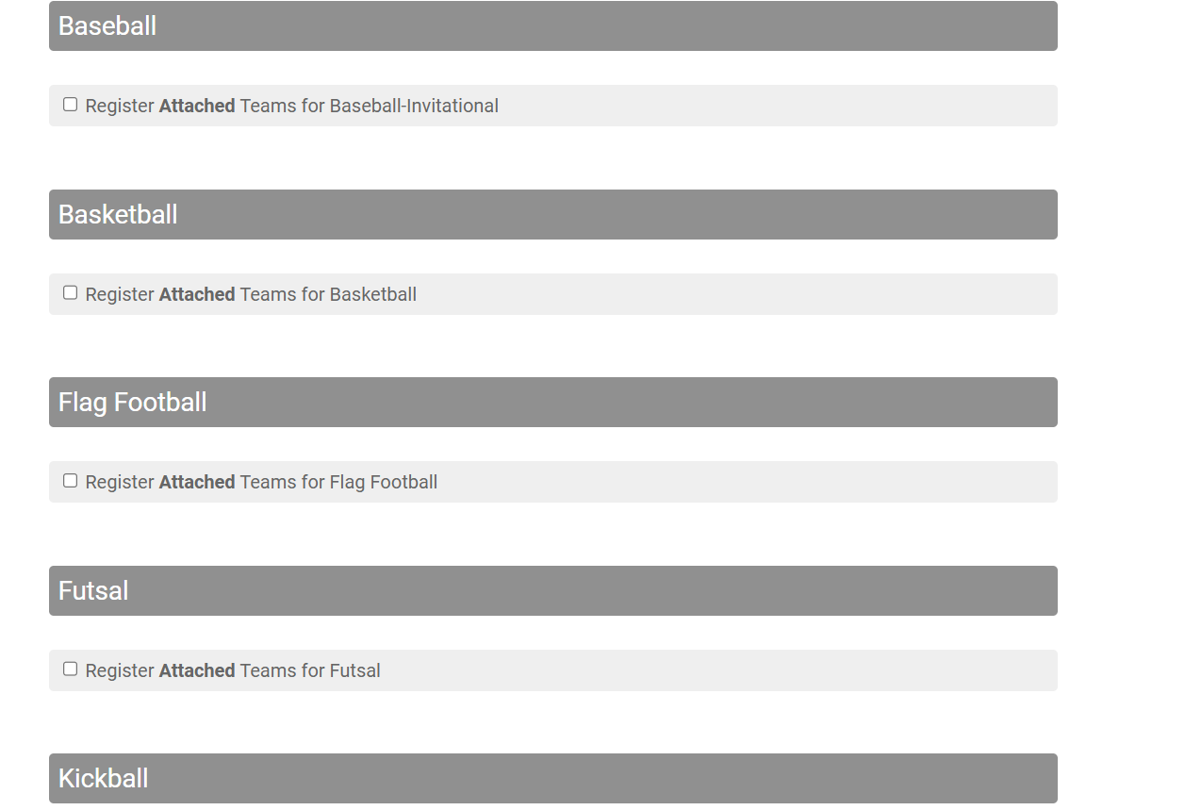
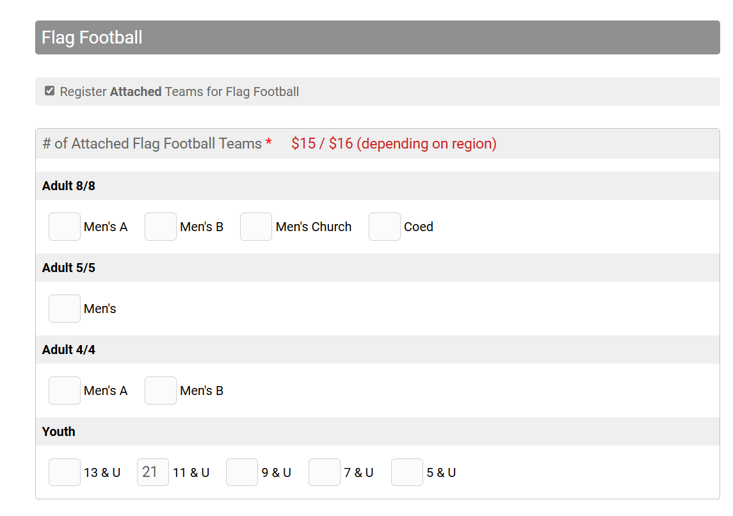

Slide 7
Why step 2
Regional and State Tournaments
What is needed:
Tournament Hosts need to know that the team is registered with TAAF (insurance purpose), the names of the teams with their coaches information, and rosters to verify athletes.
Team Name
Coaches Information
Rosters

Slide 8
Options on step 2
ROSTERS:
TEAM INFORMATION
You can upload a file of your rosters already signed
Enter in your roster information (athletes information)
When logging in to Step 2, you can change the team registration to the correct team name. Example: (35) 11U Youth Flag Football Team 1 – Team TAAF
Then you can change the contact to the coaches information (needed for any verifications or questions and to be able to share information with coaches)
Upload or enter rosters, needed for insurance purposes. If entering rosters, you will receive a link to send to parents for signatures for a waiver.

Slide 9
You can also find Step 2 at the top of the page from Step 1 – Team Mgmt.

Slide 10
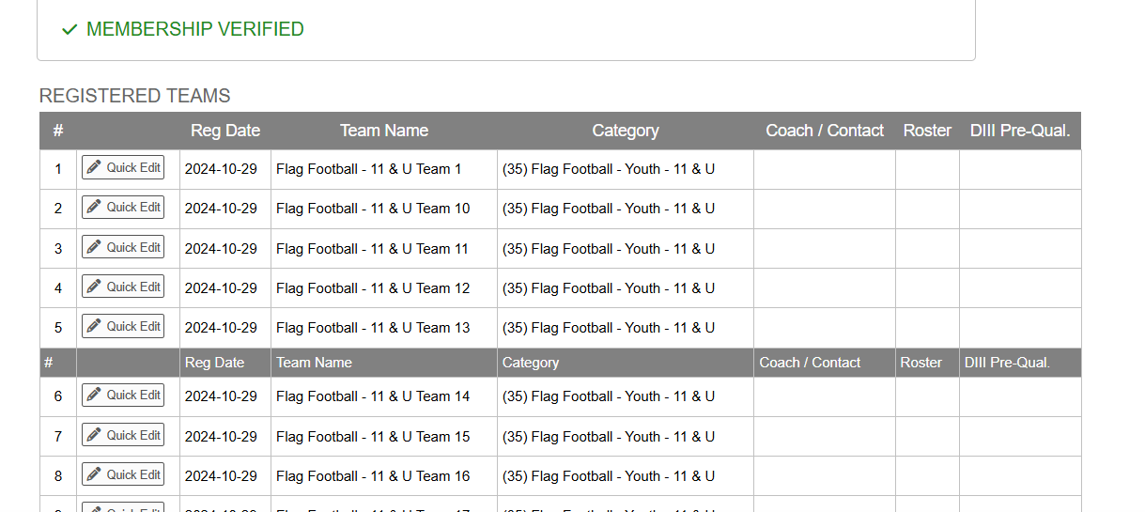
Step 2 – Team MGMT.
Click the Quick Edit button next to each team to update team name, add in coaches information, upload or enter rosters and upload any other needed documentation.

Slide 11
Edit a submission
Continue improving

Slide 12
Registration deadlines
Team Registration Deadlines with the State Office
DEADLINES:
Team Registrations by Sport for the State Office are most time not the same as registrations with the tournament host, please make sure your teams are registered with TAAF prior to registering for the State Tournament
Sport | Deadline
Basketball - Adult | One Business Day after the State Tournament Entry Deadline
Basketball - Winter - Youth/High School | January 15
Flag Football - 8 on 8 | November 1
Flag Football - 4 on 4 | March 1
Flag Football - Youth | November 1
Hockey - In-line | Register at State Tournament
Kickball | Register at State Tournament
Soccer | Register at State Tournament
Softball - Spring/Summer - Adult/Youth | June 1
Softball - Fall | Register at State Tournament
Volleyball - Adult | Register at State Tournament
Volleyball - Sand | Register at State Tournament
Volleyball - Youth | April 15

Slide 13
If you have any question or need help, please reach out to the state office
Sarah Morris or Ginger Koehn
512-863-9400
taafstateoffice@gmail.com
ginger@taaf.com
www.taaf.com

